Slide 1
Minicycle.en
20210730

Slide 2
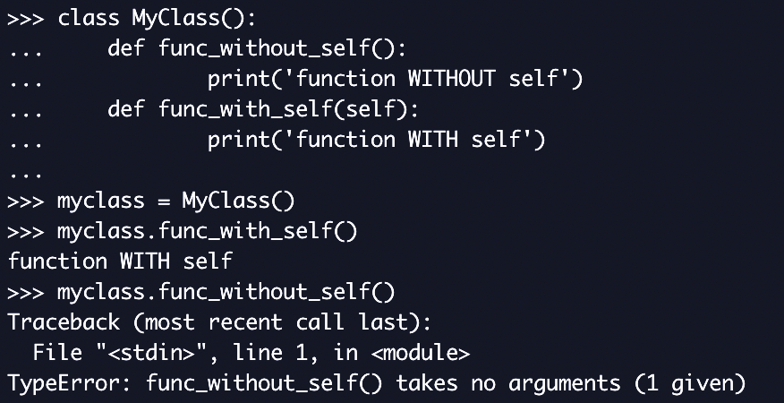
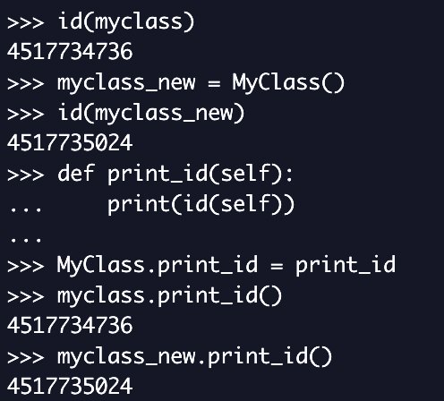
Self

Slide 3
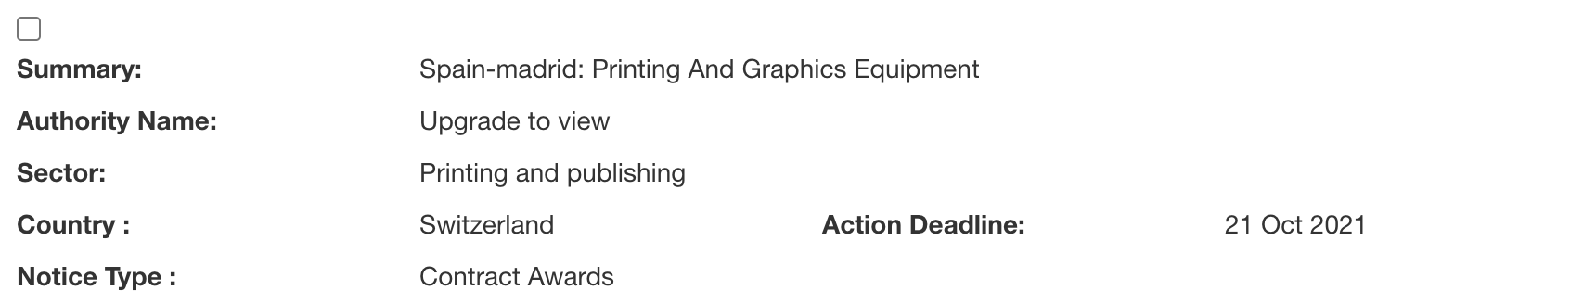
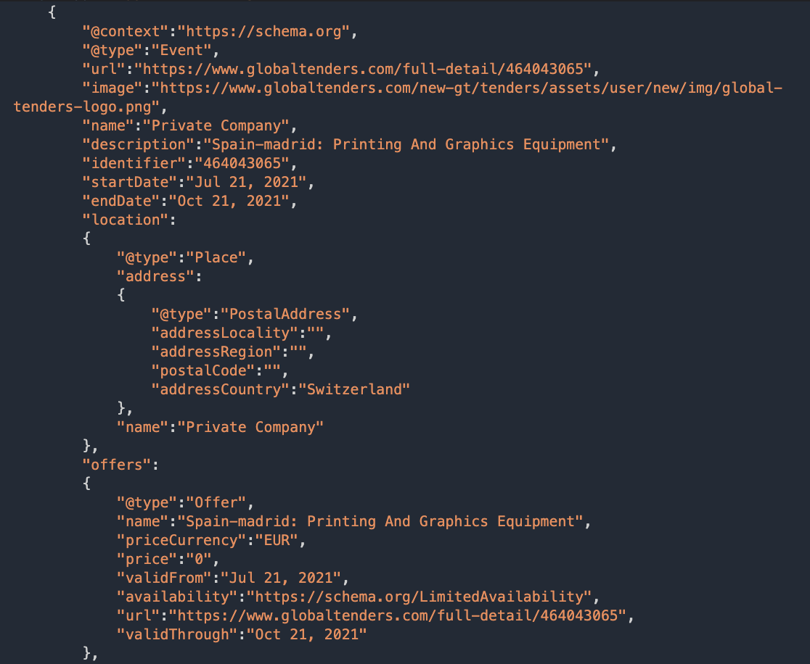
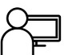
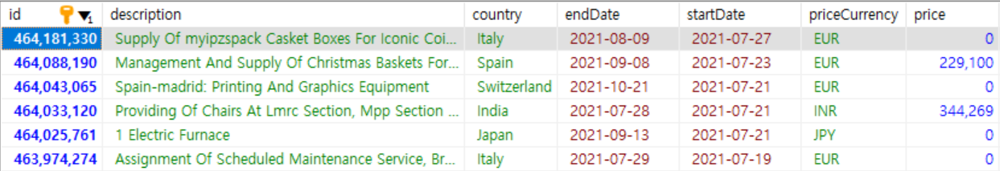
Tenders
keyword
scraping
user
parsing
storing

Slide 4
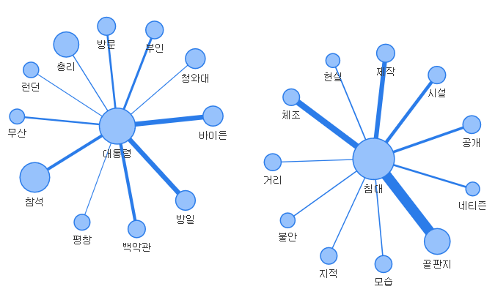
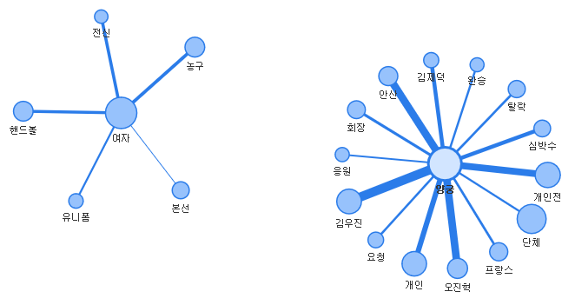

Slide 5
Architecture
SimpleWorker
TinyProcesser
dataset
Graph
Scraper
targets
본문, 언어
News
Topic
링크, 제목, 본문, 날짜, 검색어, 언어, 상태
Loader

Slide 6
Workflow
Data Load
Preprocessing
Candidate Extraction
Candidate Filtering
Visualization
Association analysis
Count-based Ranking
Bilingual

Slide 7
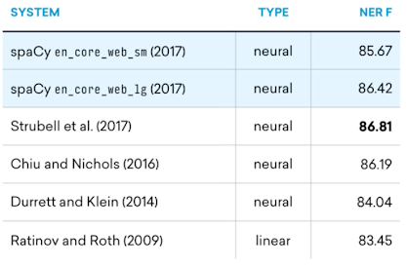
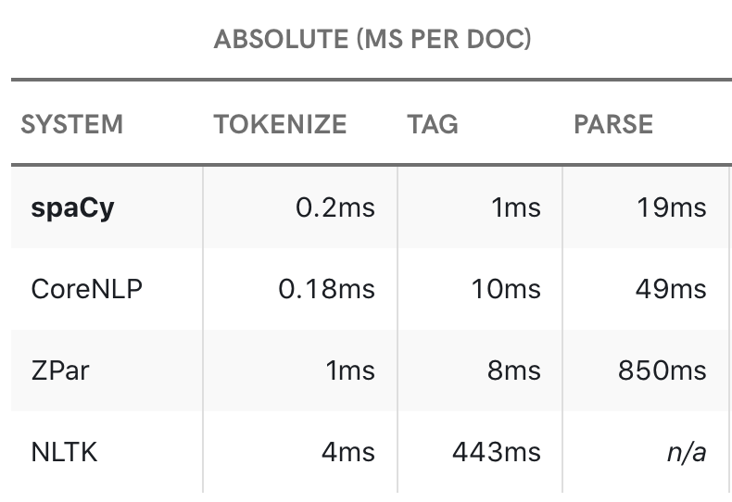
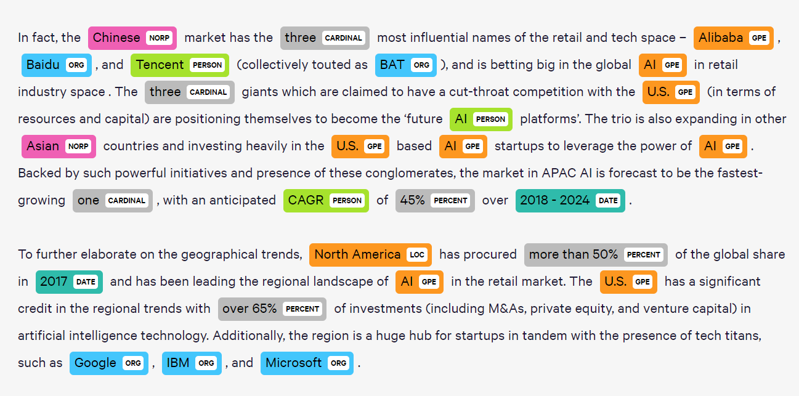
Candidate Selection
한국어: soynlp – LRNounExtractor ver.2
영어: spacy – NER(Named Entity Recognition) & Noun chunk
NER
Spacy 2.0 performance

Slide 8
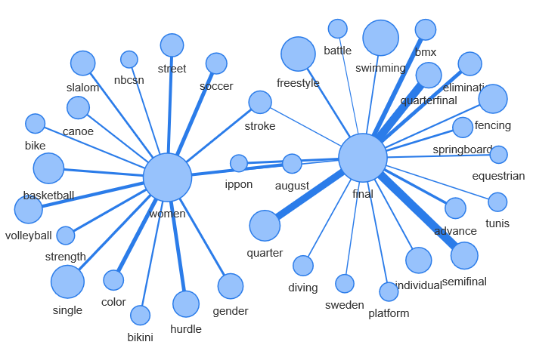
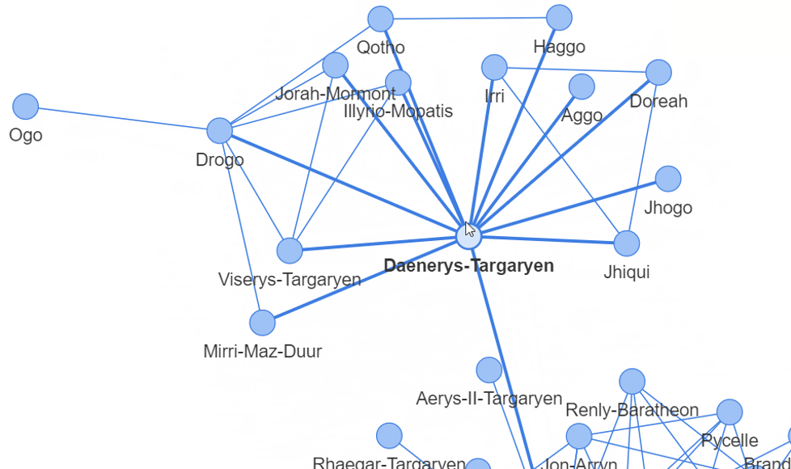
Visualize
Wordcloud
wordcloud
Network
Networkx
+ pyvis
+ ?

